Slide 1
BORO – General Context
C-FORS Summer School in Foundational Ontology (C-FORS 2025)
23 May 2025, University of Oslo, Norway
Chris Partridge, Chief Ontologist, BORO Solutions

Slide 2
Schedule
Morning Sessions
 | 9:00 - 9:05 | Session 0 – Introduction
 | 9:05 - 9:45 | Session 1 – Context
 | 10:00 - 10:45 | Session 2 – BORO Ontology
 | 11:00 - 12:00 | Session 3 – Analysis Tools
Afternoon Sessions
 | 1:15 - 3:30 | Session 1 – Practical Examples
 | 3:30 - 5:00 | Session 2 – Examples Discussion / Presentation

Slide 3
Session 1 – Context: Structure
Overall approach
Context
ontologies
foundational ontologies – purpose
foundational ontologies – nature

Slide 4
Overall approach

Slide 5
Overall practice-focused approach
A common way of looking at engineering,
including ontological engineering,
is as a practice, a way of doing things
engineering as a discipline emerges from and supports the practice
Foundational ontology engineering, or
ontological engineering using foundational ontologies,
is then also a practice
Aim is to give some idea of the practice of using the BORO Foundational Ontology

Slide 6
First step
Start by providing a general context to situate the BORO practice
frame this with three questions
why bother with ontologies?
why bother with foundational ontologies?
what kind of thing are foundational ontologies?
the way we answer these questions provides a frame for understanding BORO’s approach to foundational ontology

Slide 7
Ontologies
Why bother with ontologies?

Slide 8
Why bother with ontologies?
A common (almost universal?) answer
(which we subscribe to)
is
they are useful/needed for (the practice of) improving interoperability
particularly semantic interoperability
“However, knowledge-based systems pose special requirements for interoperability. … For such knowledge-level communication, we need conventions at three levels: representation language format, agent communication protocol, and specification of the content of shared knowledge. … Ontologies can be used for conventions of the third kind: content-specific specifications”
Gruber, T. R. (1993). A translation approach to portable ontology specifications. Knowledge Acquisition, 5(2), Article 2. https://doi.org/10.1006/knac.1993.1008

Slide 9

What is interoperability?
Term only started appearing in the 1960s
recognised as a capability
Genealogically: the definitions reveal a shift in emphasis
in the early days, interoperability,
particularly semantic interoperability,
was theoretically defined in terms of a capability to understand
talk about ‘meanings’
however, as people studied the problem,
this has evolved into seeing it as an operational capability
talk about being able to do things
Operational capability definition is more common nowadays among practitioners
Early (theory):
interoperability among components of large-scale, distributed systems is the ability to exchange services and data with one another. … Semantic interoperability ensures that these exchanges make sense—that the requester and the provider have a common understanding of the “meanings” of the requested services and data.")
Heiler, S. (1995). Semantic interoperability. ACM Computing Surveys (CSUR), 27(2), 271–273.
Evolved (pragmatic – operational):
within the past decade, it has been commonly defined as “The ability of systems, units, or forces to provide services to, and accept services from other systems, units or forces and to use the services so exchanged to enable them to operate effectively together.”
Ford, T. C., Colombi, J. M., Graham, S. R., & Jacques, D. R. (2007). A survey on interoperability measurement. Gateways, 2(3)

Slide 10
If interoperability is recent, why now?
The genealogy of (the term) interoperability shows,
as noted, it is relatively recent
term only started appearing in the 1960s
emerged around the same time as use of computing in enterprises/institutions
closely linked to computers/machines working together
This implies a connection with computing
not the same kind of concern prior to computing

Slide 11
What kinds of computing (machine) interoperability?
If the new concern is
how does communication work in the age of computing machines?
This naturally gives rise to a three-way distinction
based on the types of systems doing the exchange
Machine-Machine
Machine-Human
Human-Human
of these three – the first (and second) seem novel
the third is plainly not novel!
we will argue that as automation increases
more and more information is communicated from ‘Machine-Machine’

Slide 12











Visualising the three-way distinction
all the components for a digital information ecosystem have emerged: storage, processing and communication?
brain
external
pre-speech
speech
text
digital
communication
processing

Slide 13


Ancient Human-Human lack of interoperability
Tower of Babel narrative in Genesis 11:1–9 speaks to the power of interoperability and to the curse of not having it.
And the LORD said, "Look, they are one people, and they have all one language, and this is only the beginning of what they will do; nothing that they propose to do will now be impossible for them. Come, let us go down and confuse their language so they will not understand each other.”
In this ‘myth’, implausibly, the journey is ‘backwards’ from being interoperable to not being interoperable

Slide 14

Opportunities for improving (machine-machine) interoperability capability
Different ways to ‘lack’ (machine-machine) interoperability capability
failing (existing) capability
common example
failures in ‘accuracy’ of existing interoperability capability
Mars Reconnaissance Orbiter – imperial versus metric
(new) capability gaps
not in the current (existing) capability
common example
curation requirements in data lakes
raw data does not interoperate – it needs prior curation
curation is expensive, so limited
From an opportunity exploitation perspective
capability gaps offer more opportunity for machine-machine exploitation
obvious area for improvement is reducing cost of ‘curation’ (i.e. interoperability)

Slide 15
A Coasian ‘metric’ for the cost of interoperability
a simple synchronous interoperability test
We can use intra-operability as a benchmark to assess interoperability.
The goal is for the costs of intra- and inter-operability to be roughly comparable.
It should be (roughly) as easy to communicate within as across systems.
machines talking to themselves
machines talking to other machines
intra-operability
inter-operability
system a
system b
system a
system b
system a
system b
system a
system b
Coase, R. H. (1937). The nature of the firm. Economica

Slide 16
The rise of machine-machine interoperability

Slide 17
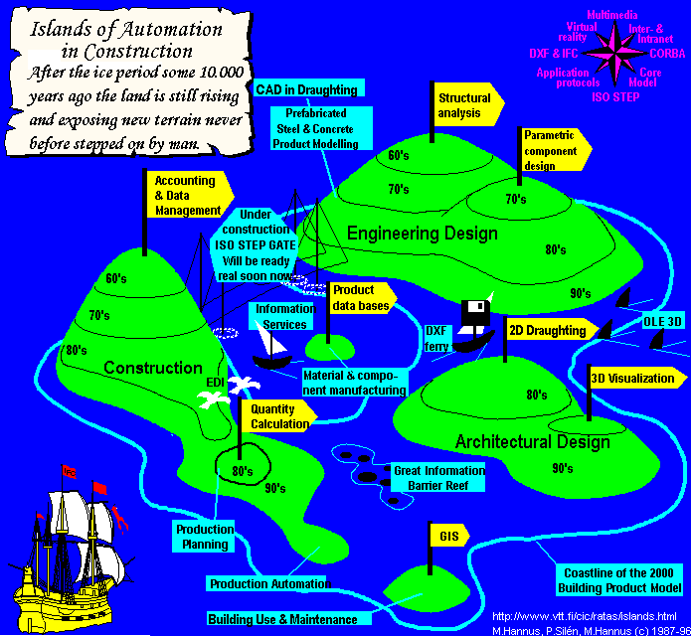
Metaphor from the 1980s: islands of automation in construction
Islands are data (digitised)
Sea is pre-data (manual)
This version is from1996
Height of the island shows when data emerged:
nothing before the 60s
https://en.wikipedia.org/wiki/Islands_of_automation
https://en.wikipedia.org/wiki/Islands_of_automation
see also: Bjork, B. (1987) The integrated use of computers in construction - The Finnish experience, ARECCAD 87, Barcelona,

Slide 18
Expanding – over time - islands of automation
tl;dr – as systems grow, they abut and so need to communicate
time
As the islands expand (automation increases), the systems abut – and so,
the need to communicate (interoperability - data exchange) arises and increases.
The typical enterprise is now so automated that it no longer makes sense to talk about ‘expanding islands’ of automation … maybe, given the size, ‘continents of automation’. However, it does still make sense to look at the bridges between the islands/continents.

Slide 19
4D perspective reveals vertical and horizontal data exchange
System migrations, and their integral data migrations, are diachronous.
Where the time axis goes up the page, these can be thought of as vertical migrations.
By the same reasoning, system to system APIs are synchronous and so can be thought of as horizontal exchanges.
key
system
diachronous migration
synchronous exchange (API)
time
vertical
horizontal

Slide 20
The significant scale of interoperability
As systems get bigger, and
the types of data typically increase
the size of the task of ensuring interoperability increases
Systems are now quite big
some idea of the scale
take as a reference a common enterprise application:
for example, SAP ERP (https://en.wikipedia.org/wiki/SAP_ERP)
a typical system may have 40,000 tables with over 1 million columns
anecdotal evidence that systems on average get replaced every decade or so
so, an enormous amount of migration going on

Slide 21
Narrow alleyways of machine interoperability
Returning to the ‘capability gaps’ way to ‘lack’ (machine-machine) interoperability capability
When one looks more closely at current interoperability, it becomes clear that the data scope is very narrow.
In other words, the capability gaps are wide
This becomes particularly apparent when we attempt to integrate data
for example, when multiple systems’ raw data is merged into data lakes
the data usually needs curating (transforming) before it is interoperable
the cost of this is significant, prohibitive.
narrow
broad

Slide 22
Lack of integrated interoperability
The narrow data scope of the interoperability is a marker of missed opportunities – a ‘capability gap’
it is a symptom of our inability to fully exploit the information in our systems
it is ubiquitous and endemic
every application system seems to exhibit this feature
it grows as our systems grow
each new system creates another barrier to integrated interoperability
better exploitation requires better tools
ones that significantly reduce costs

Slide 23
Process versus the end product

Slide 24
Process versus the end product
There appears to be a natural general tendency in engineering to focus on the end product and not take much account of its life cycle.
In the context of top-level ontologies, this results in a focus upon the ontology (even the top ontology)
and significantly less attention, sometimes no attention,
on the ontologisation process from which this emerges.
this is clearly reflected in the current status of work on computational top-level ontologies.
Chris Partridge, C., Mitchell, A., de Cesare, S., Beverley, J. (2025). "Broadening Ontologization Design: Embracing Data Pipeline Strategies". https://www.academia.edu/129382330

Slide 25
Process versus the end product in logic
As (Dutilh Novaes, 2015) notes, in the context of logic, the process of formalisation is often neglected, and attention is focused on the formal results.
She notes the importance of the former for real life application of the latter.
She discusses two historical examples of processes of logical formalisation:
Aristotle’s syllogistic theory from the “Prior Analytics”, and
medieval theories of supposition,
to both illustrate and illuminate how to formalize logical arguments.
Dutilh Novaes, C. (2015). "The formal and the formalized: The cases of syllogistic and supposition theory". Kriterion: Revista de Filosofia, 56, 253–270.
See also:
Dutilh Novaes, Catarina. 2012. Formal Languages in Logic: A Philosophical and Cognitive Analysis

Slide 26
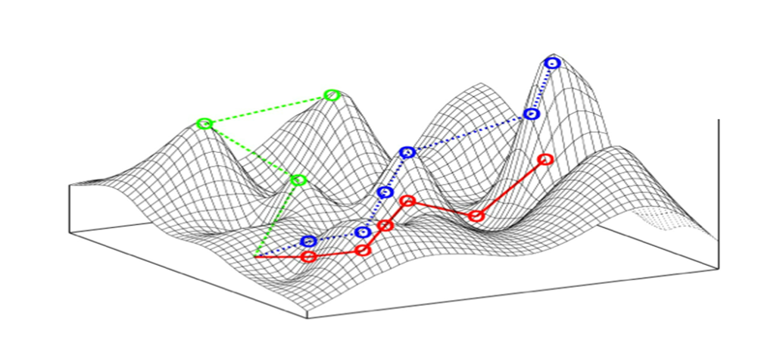
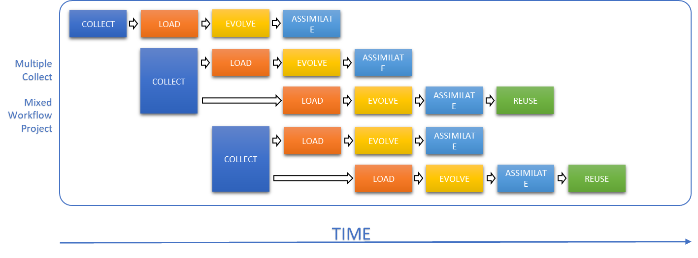
The current formalisation process
Formalisation is:
an iterative, (discovery,) empirical exercise
should aim to ‘let the data speak’
in evolutionary terms,
exploring the paths through the fitness landscape
Current situation
the formalisation process
is largely unexamined (AKA unmanaged)
typically, uncritically gives control of the form to the syntax

Slide 27
Exploitation opportunity
This suggests an exploitation opportunity
improving the end product
by better engineering the process
the improved engineering is a way to reduce the capability gap
increasing interoperability with a better engineered process

Slide 28
A closer look at a ‘capability gap’: in the ‘data exchange process’

Slide 29

Look more closely at a ‘data exchange process’
time
Schematically, there are end nodes. The data exchange migrates and transforms data between these nodes.
The transformation changes the data from the format of one system into the format of another

Slide 30
Data exchange transformation
The data exchange involves the transformation of data in the format of one system into the format of another
Review two aspects of the transformation
transformation as translation and
translation reflecting reference

Slide 31

Translation - interlingua
Translation via an interlingua (language)
Use a common interlingua as the hub for each translation spoke.

Slide 32


Reference - triangulate
domain
ontology
Triangulate the mapping using ‘reference’ to objects in the domain – that is, a domain ontology
This assumes the systems represent (refer to) the same things in the world.

Slide 33
Why bother with ontologies?
Because improving interoperability is key to improving computer ecosystems, and
ontologies enhance interoperability
by helping to enable the use of reference
to triangulate the interlingua translation
in the data exchange process

Slide 34
Foundational ontologies – purpose
Why bother with foundational ontologies?

Slide 35
Why bother with foundational ontologies?
We have a domain ontology
Why do we need a foundational ontology?
Show that:
the domain ontology, on its own, is undermined by ontological relativity’s
three theses of indeterminacy
this indeterminacy is resolved by the foundational ontology

Slide 36
Quine’s three theses of indeterminacy
Ontological relativity is underpinned by three theses of indeterminacy
“Three theses of indeterminacy have figured conspicuously in my writings:
indeterminacy of translation,
inscrutability of reference, and
underdetermination of scientific theory.”
Quine, W. V. O. (2008). Three Indeterminacies.
NOTE: translation and reference are key to successful interoperability
Regarded as an important topic: for example:
“W. V. O. Quine’s contention that translation is indeterminate has been among the most widely discussed and controversial theses in modern analytical philosophy. It is a standard bearer for one of the late twentieth century’s most characteristic philosophical preoccupations …”
Crispin Wright (1999). "Chapter 16: The indeterminacy of translation
Leave aside the controversy
we can use this to explain the role of foundational ontology
as a tool to manage metaphysical indeterminacy

Slide 37
Three consequences of indeterminacy
There may be no unique way to:
translate between two languages
so, no single candidate interlingua
weakens the translation interlingua approach
determine the reference of terms in the languages
so, no unique set of real-world objects to refer to
weakens the real-world approach
build a scientific account of our empirical data
so, we cannot empirically test our theories
Roughly:
the metaphysics deals with the ‘stuff’ science cannot

Slide 38
For more background on Quine’s ontological relativity
WVO Quine’s essay, “Ontological Relativity” (1969) turned 50 in 2019
Recurring topic in his work, see (for example):
1960, Word and Object
1970, On the Reasons for the Indeterminacy of Translation
1974, The Roots of Reference
1975, On Empirically Equivalent Systems of the World
2008, Three indeterminacies
…
See also: https://plato.stanford.edu/entries/quine/#UndeTheoEvidIndeTran

Slide 39
Why bother with foundational ontologies?
The domain ontology, on its own, is undermined by ontological relativity’s
three theses of indeterminacy
There are metaphysical choices that aren’t empirical
Foundational ontologies are a way to regain determinacy
the foundational ontologies address these choices in a systematic metaphysical architecture
this mitigates the indeterminacy
but, it can be resolved in multiple ways,
by foundational ontologies with different metaphysical architectures
in other words, there are multiple possible foundational ontologies

Slide 40
Visualising the revised architecture
foundational
ontology
domain
ontology

Slide 41
Whither truth?
The existence of multiple foundational ontologies,
where the choice between them cannot be determined by empirical tests
is evidence of the indeterminacy
But what happens to ‘truth’ in this situation?
“This is an issue on which Quine has not merely changed his mind but vacillated, going back and forth between what he calls the “sectarian” and the “ecumenical” responses.
the sectarian response is to say that we should not let the existence of the alternative in any way affect our attitude towards our own theory: we should continue to take it seriously, as uniquely telling us the truth about the world. (We are assuming that the two theories possess all theoretical virtues to equal degree; clearly Quine would say that if one theory were superior in some way then we would have reason to adopt it.)
the ecumenical response, by contrast, counts both theories as true.”
https://plato.stanford.edu/entries/quine/#Unde

Slide 42
Foundational ontologies – nature
How do foundational ontologies resolve this indeterminacy?

Slide 43
Explaining the nature of foundational ontologies
One way of characterising the indeterminacy is through metaphysical choices
A foundational ontology makes a range of metaphysical choices in a coordinated way
this results in a metaphysical architecture
the range of the metaphysical choice is what generates indeterminacy
making the metaphysical choice resolves the indeterminacy
So, one way of explaining the nature of foundational ontologies is through the metaphysical choices that underpin their metaphysical architecture

Slide 44

Example category of architectural choice: whether to stratify or unify
One of the categories of architectural choice: horizontal aspects
“4.2.2 Horizontal aspects: stratification versus unification
There is a group of fundamental choices that impact the ontological architecture which involves whether or not to make a distinction. If one chooses not to make the distinction, one only introduces a single type. If one chooses to make the distinction, one introduces two types; one for each alternative. The choice boils down to whether to horizontally stratify or unify. One can describe choosing to make the distinction as ‘separating one potentially unified type into two’, creating a horizontal stratification in the hierarchy – and not making the distinction, ‘unifying the potentially separated two types into one’.”
web-based: https://digitaltwinhub.co.uk/a-survey-of-top-level-ontologies/#a_survey_of_TLOs_contents

Slide 45
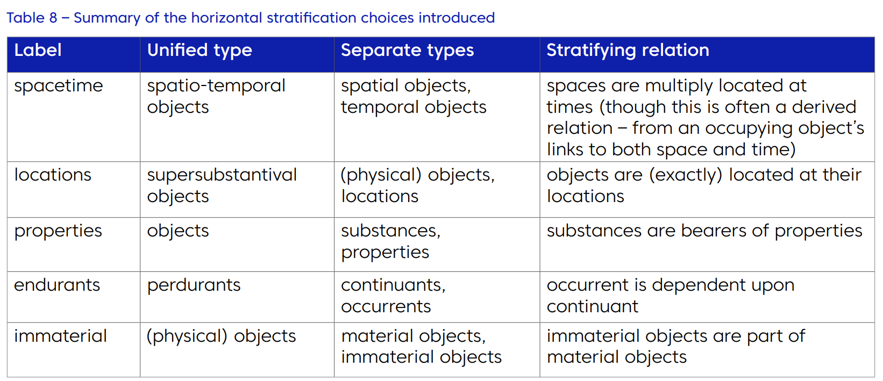
Example: Stratification as a journey
4.2.2.7 Stratification journey
There is limited inter-dependence between the choices meaning that a range of permutations are possible. For a top-level ontology, one can visualise the architectural stratification choices being adopted in a sequence, starting with no stratifications and introducing the choices one or two at a time – as illustrated in the figures below. This sequence or journey is a rational reconstruction – the original development of the top-level ontology is most likely ad hoc and bottom up. However, this reconstruction gives us a good picture of the underlying architecture.

Slide 46
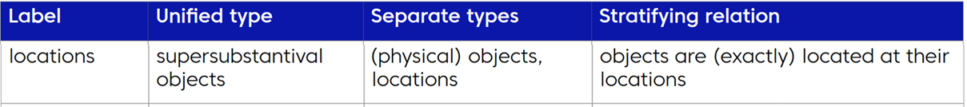
Example metaphysical choice: locations
web-based: https://digitaltwinhub.co.uk/a-survey-of-top-level-ontologies/#a_survey_of_TLOs_contents
4.2.2.2 Locations People often talk of physical objects and their locations, where physical objects occupy their locations, suggesting two related types; objects and locations (let’s leave the decision whether the location is spatial, temporal or spatiotemporal to the previous choice). For example, “today your car is parked in the same place as mine was yesterday” could be regarded as a location which was occupied by my car (a physical object) yesterday and your car today. There is a debate going back to Newton and Leibnitz in the 17th century as to whether location is absolute or relative. If it is relative, then location is clearly fundamentally different from physical objects – which aren’t. However, if it is absolute, a kind of substance, then this opens the possibility that one could unify objects and their locations as fundamentally the same, technically known as supersubstantivalism. If one does not have cases of interpenetration (see 4.3.3) then this resolves the oddity where physical objects exactly occupy a single location throughout their life – unifying eliminates this double counting. If there is interpenetration, then two objects may collapse to the same location – which may have unintended consequences. After the unification, the physical object and its location, two kinds of substance, are replaced by a single supersubstantival object. One has a broad choice between separating or unifying physical objects and locations.

Slide 47
Two (of many) levels of unifying-stratifying
more unified
supersubstantival objects
matter and the space-time it is located in are unified as supersubstantival objects – matter is then a way space-time can be
supersubstantival objects
material entities
located
at
spatio-temporal
locations
locations in space and locations in time are unified as locations in space-time
spatio-temporal
locations
more stratified
spatial locations
happens
at
temporal locations
web-based: https://digitaltwinhub.co.uk/a-survey-of-top-level-ontologies/#a_survey_of_TLOs_contents

Slide 48
Locations example choice
unified
separated
(unified) entities
(separated) entities
Legend
maps to
subset of
super-substantival objects
locations
instance of
located at
super-substantival (physical) objects
(physical) objects
location 1
super-substantival (physical) object 1
(physical) object 1

Slide 49
The HMELR test
We developed the HMELR test
to expose the implicit ‘horizontal’ metaphysical choices
Acronym:
How-Many-things-Exactly-Located-in-this-Region?
Basing the test on a region is empirically conservative
it does not introduce empirical differences
The test trades on
a difference
stratification: leads to a multiplication of exactly coinciding objects of the stratified types
and a linking relation between the types
unification: leads to a collapse into a single object of the unified type
with identity as the linking relation (if you need one)
this difference leads to a difference in numerical identity
the count reveals the underlying metaphysical choice
The ‘numerical identity’ difference
also illustrates how data behaves under the choice
multiplying objects leads to multiplying their representations (rows, etc.)

Slide 50
Locations example - HMELR test
unified
separated
(unified) entities
(separated) entities
super-substantival objects
locations
super-substantival (physical) objects
(physical) objects
location 1
super-substantival (physical) object 1
(physical) object 1
1
HMELR
2

Slide 51
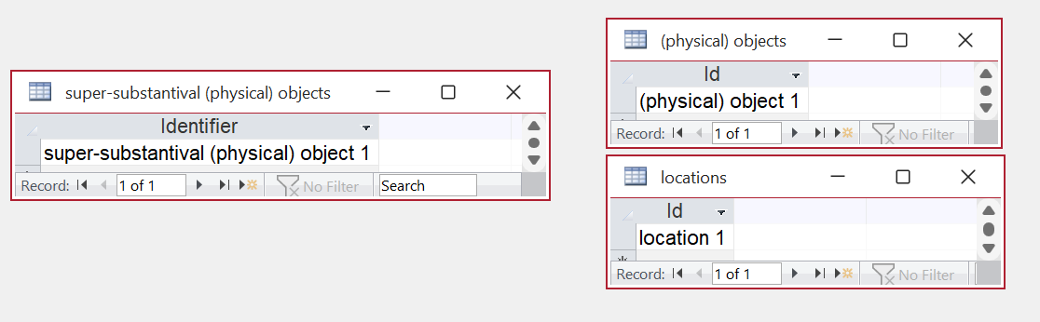
Corresponding database indeterminacy
There is a corresponding ‘numerical identity’ difference for data behaves under the choice.
Multiplying objects leads to multiplying their representations (rows, etc.)
super-substantival database
substantival database

Slide 52
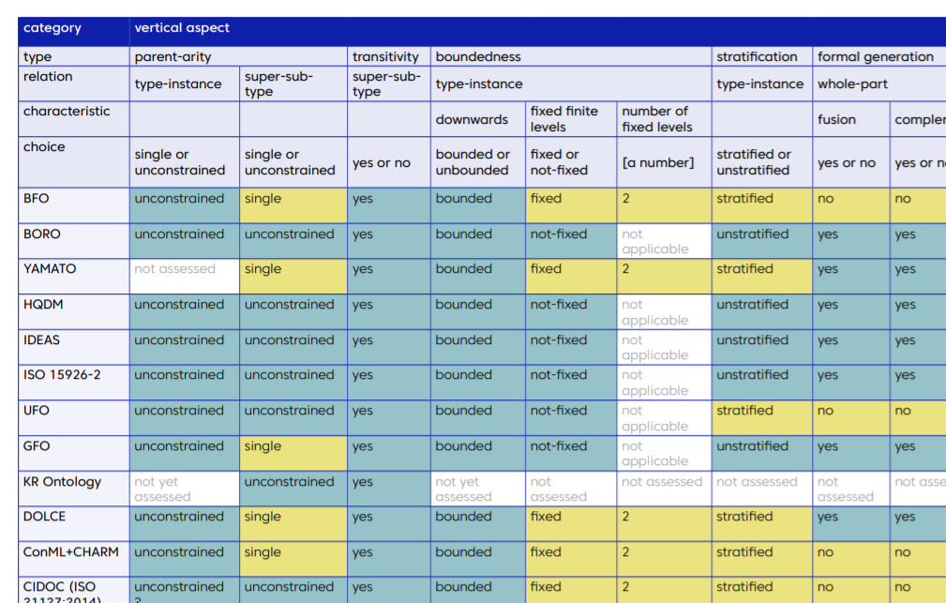
A framework for: mapping the metaphysical architecture landscape
A map to navigate the different architectural possibilities
Appendix E: Summary of Framework Assessment Matrix Results
31 ontological choices
37 top ontologies shortlisted and assessed
The ontological choices shape the architecture of the ontology
https://www.repository.cam.ac.uk/handle/1810/313452
web-based: https://digitaltwinhub.co.uk/a-survey-of-top-level-ontologies/#a_survey_of_TLOs_contents

Slide 53
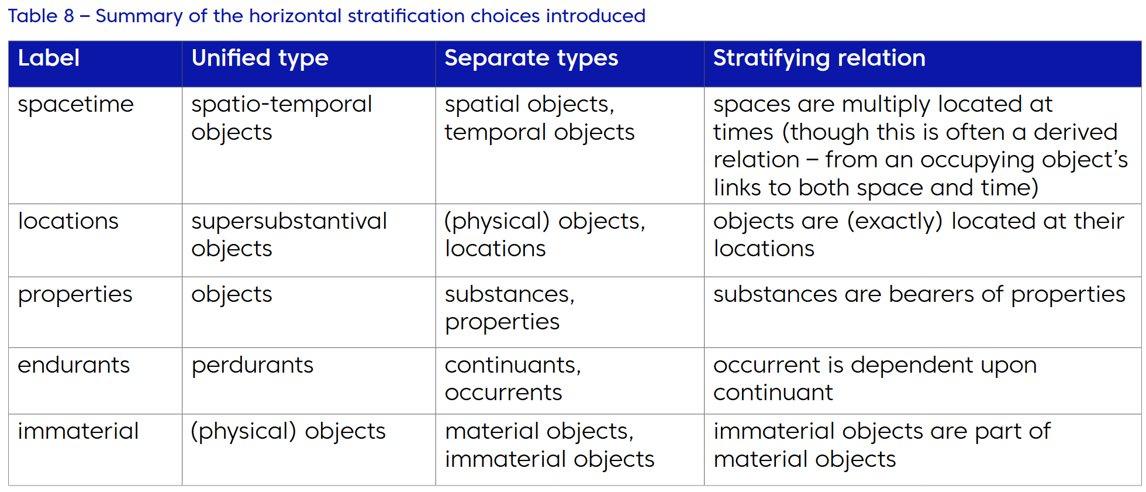

Mapping the metaphysical architecture landscape
Horizontal stratification choices
web-based: https://digitaltwinhub.co.uk/a-survey-of-top-level-ontologies/#a_survey_of_TLOs_contents

Slide 54
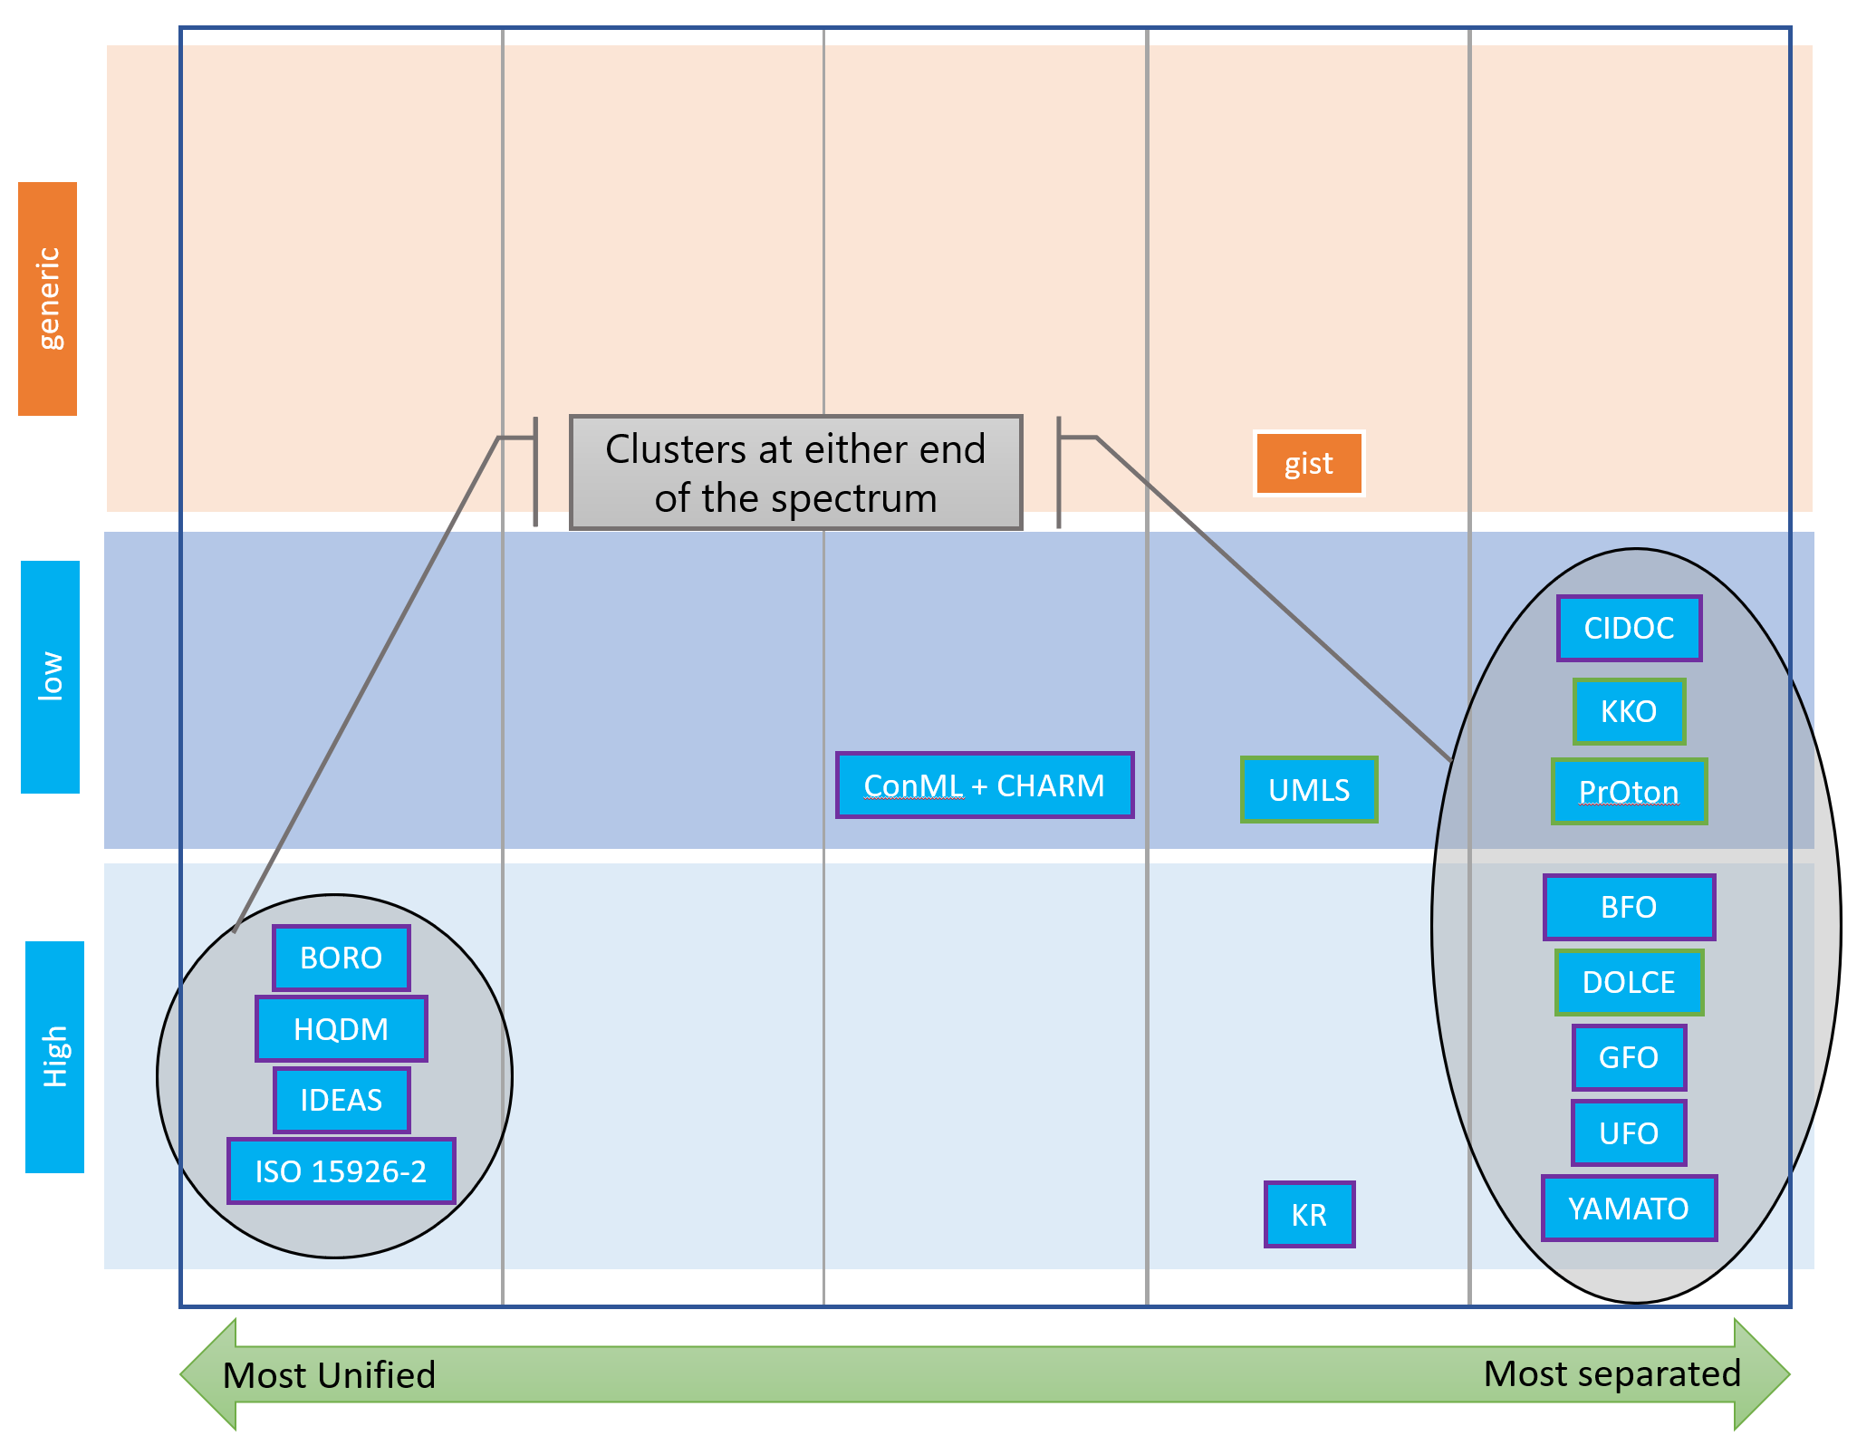
Mapping the metaphysical architecture landscape
Horizontal Aspect: Stratification Clustering
Stratification: (in the survey) unifying and separating clusters at each end of the spectrum – especially for the more ontologically commited.
Dependencies seem lead to attraction one way or the other.
web-based: https://digitaltwinhub.co.uk/a-survey-of-top-level-ontologies/#a_survey_of_TLOs_contents

Slide 55
What kind of thing are foundational ontologies?
Foundational ontologies
provide a metaphysical architecture
different top ontologies provide different metaphysical architectures
the architecture is underpinned by metaphysical choices
addressed in a coordinated way
the existence of the choice introduces indeterminacy
making the choice resolves the indeterminacy
resolving the metaphysical indeterminacy
makes translation and reference (more) determinate
enabling better interoperability

Slide 56
Summary

Slide 57
Summary
Improving interoperability is key to improving computer ecosystems, and
ontologies enhance interoperability
by helping to enable the use of reference
to triangulate the interlingua translation
in the data exchange process
but these are undermined by ontological relativity’s indeterminacy
Ontological relativity’s indeterminacy can be resolved by a foundational ontology
it can be resolved in multiple ways,
by foundational ontologies with different metaphysical architectures
in other words, there are multiple possible foundational ontologies
Foundational ontologies
provide a metaphysical architecture
the architecture is underpinned by metaphysical choices
resolving these resolves metaphysical indeterminacy
makes translation and reference (more) determinate
enabling better interoperability

Slide 58

Questions

Slide 59


Slide 60


